Slide 1


UNIVERSITY OF BURGUNDY
CONDORCET DE L'UNIVERSITÉ DE BOURGOGNE
PROJECT ON
ENDOCARDIAL BOUNDARY EXTRACTION IN LEFT VENTRICULAR ECHOCARDIOGRAPHIC IMAGES USING FAST AND ADAPTIVE B-SPLINE SNAKE ALGORITHM
PREPARED BY:
MR. MANUEL OJEDA
MR. TAREKE TEWELE WELETNSEA
18/12/2020

Slide 2

Index
3.- Abstract
4.- Introduction
5.- Background
6. Methodology
8.- Experiment and results.
12.- Conclusion
18/12/2020

Slide 3
Abstract
In this work, our motivation is to develop framework for semi-automatic segmentation Using Fast and adaptive B-Spline snake algorithm.
The main goal is endocardial boundary extraction for the left ventricular heart.
B-spline snake algorithm has good performance with efficient Boundary detection MRI images.
This algorithm uses Balloon and GVF forces towards desired image features.
18/12/2020

Slide 4
Introduction
Image segmentation is an important step for large-scale image analysis and object recognition into multiple segments.
B-Spline Snake approach is one of the well-known method used by researchers to approximate the contour of encountered obstacles in image segmentation.
B-spline is used to find the transformation, which is a linear combination of the columns of the B-spline basis.
A snake is a curve that evolves from an initial position towards the boundary of an object.
18/12/2020

Slide 5
Background
A number of literature have been done about B –spline snake algorithm.
Among several available approaches, active contours, introduced by Kass have shown remarkable performance.
Most of time, low-pass filtering and morphological operations are used to define an initial estimate of the contour.
Currently, B-Spline snakes algorithm is described either implicitly (e.g., level sets) or explicitly.
Widespread applications have been developed in medical image segmentation by this B-spline snake approach.
18/12/2020

Slide 6
Methodology
A innovative combination of gradient vector flow and balloon force is employed to drive the contour towards the boundaries
The most fundamental steps to accomplish this project task are.
Load the required the image.
Convert image format and rotate to desired degree(90, 180 and 270).
Contour initialization or getting the control point.
Applying Internal and External energy to the elastic snake.
Apply GVF and balloon force field to push the contour into the desired boundary or rate of convergence.
Segmentation area with active contour or snake movement.
18/12/2020

Slide 7
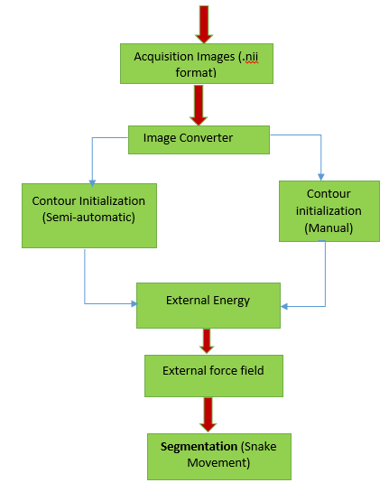

Cont’d
Block diagram of B-Spline snake algorithm.
18/12/2020

Slide 8

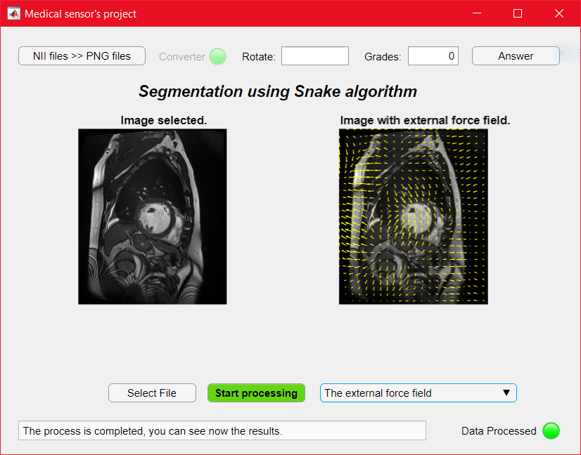
Experiments and result
We evaluate the segmentation performance on the original datasets of automated cardiac Diagenesis Challenge (ACDC).
The result evaluated from the implementation are presented below.
18/12/2020

Slide 9
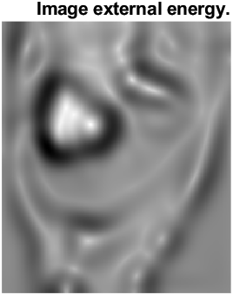
Cont’d
We have completed step 1 and step 2 in the pervious slide
Step-3
Internal energy term is to control the deformations made to the snake.
External energy term is to control the fitting of the contour onto the image.
18/12/2020

Slide 10
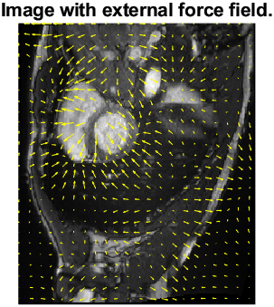
Cont’d
After some variants applied to the image.
Step-4
GVF→ Convergence performance for concave boundaries.
Balloon force prevents from shrink snake inwards if no substantial images forces are acting upon it.
18/12/2020

Slide 11
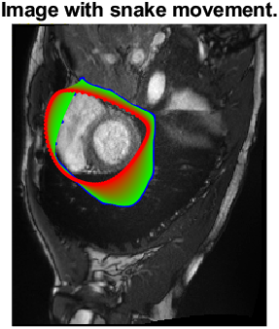
Cont’d
Snake movement or Segmentation part.
Step-5
Boundary extraction in left ventricular echocardiographic image.
18/12/2020

Slide 12

Conclusion
In this Project work we have presented our algorithm for a robust segmentation of images using B-spline snake’s algorithm.
The algorithm represented by B-spline basis functions and few control points govern the deformation.
The number 𝑀 of control points are an important parameter of the proposed snake.
The proposed framework applies a novel combination of external forces along with adaptive approach to speed up the convergence.
18/12/2020

Slide 13

Thank You
Comment, Suggestion, Question
18/12/2020

